Slide 1
By 2000 AD man should have a much better comprehension of himself and his system, not because he will be innately any smarter than he is today, but because he will have learned to use imaginatively the most powerful amplifier of intelligence yet devised.
Martin Greenberger
“The Computers of Tomorrow” The Atlantic, May 1964
Anyone can make mistakes, but it takes an expert with a computer to really foul things up.
John Mauldin and Jonathan Tepper
Endgame
Notes:
First quote from http://www2.econ.iastate.edu/tesfatsi/EconomyNeedsABM.NatureAug2009.FarmerFoley.pdf
Second quote from John Mauldin and Jonathan Tepper, “Endgame”, pg. 160-1

Slide 2
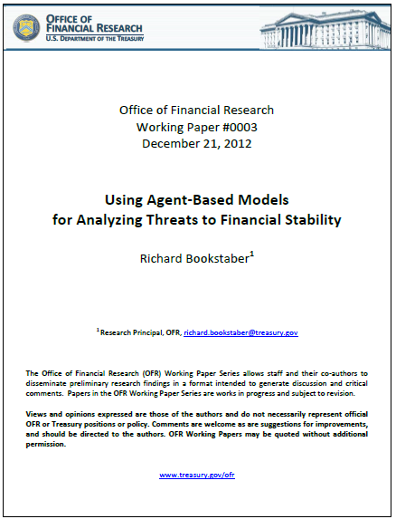
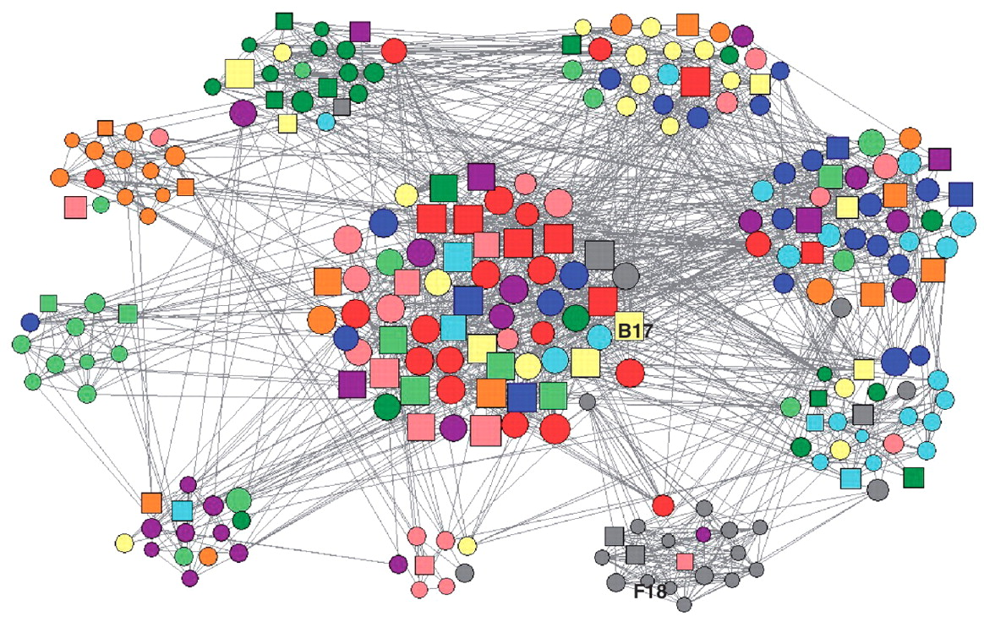
Agent-Based Modeling For Financial Risk Management
A Layman’s Deeper Dive into
the Power and Pitfalls of Agent-Based Modeling
Notes:
Left image from http://joeg.oxfordjournals.org/content/early/2011/03/27/jeg.lbr002/F3.large.jpg
Right image from http://www.treasury.gov/initiatives/ofr/research/Documents/OFR_Working_Paper_No3_ABM_Bookstaber_Final.pdf

Slide 3
Agenda
Conventional Practices in Financial Risk Management
VaR
Stress-Testing
Agent-Based Models (ABM)
Strengths
Uses in Finance and Economics
Concrete examples of ABM
Genetic Algorithm
Prisoner’s Dilemma
Dissemination of Culture
Alignment of Models
Impact of Financial Leverage
Minsky Moment Realized
Weaknesses
What Can We Learn From This?

Slide 4
Conventional Practices in Financial Risk Management
Value-at-Risk (VaR)
Developed by J.P. Morgan in the 1980s for then CEO Dennis Weatherstone, for his famous “4.15 pm report”
Uses historical data to construct normal distribution of relevant portfolio values
Determines daily value that may be lost at a normal-to-bad threshold (95%, 99%, etc.)
Adopted by Basel II for determination of risk-weighted assets
Problems with VaR
Only uses historical data, not future expectations
Assumes normal distribution
Underplays / ignores extreme tail risks
Does not necessarily include new types of securities (i.e. securities that are difficult to model and value)
Notes:
First point from Gillian Tet, “Fool’s Gold”, pg. 33
Subsequent points from here: http://www.gpo.gov/fdsys/pkg/CHRG-111hhrg51925/pdf/CHRG-111hhrg51925.pdf, pg 4
Problems from here: http://www.gpo.gov/fdsys/pkg/CHRG-111hhrg51925/pdf/CHRG-111hhrg51925.pdf, pg 56

Slide 5
Conventional Practices in Financial Risk Management
Stress-testing
Used by financial firms since the late 1980s
Also basis for Supervisory Capital Access Program (SCAP) of 2009
Risk factors are selected:
Risk factors tend to include macroeconomic variables such as:
Inflation
GDP
unemployment
commercial and residential real estate prices
equity prices
interest rates
currency exchanges
Models are developed showing factor impacts on a portfolio or institution
Discrete shocks are applied to each of those factors
Monte Carlo is one of the most widely used methods of stress-testing
Problems with Stress-testing
Relies on historical data
Models don’t capture endogenous “linkage” problems like fire-sales or runs
Exogenous shocks necessary to generate realistically fat tails are unrealistically large
Notes:
First bullet points from http://www.treasury.gov/initiatives/wsr/ofr/Documents/OFR_Annual_Report_071912_Final.pdf pg. 47
Monte Carlo point from http://www.investopedia.com/terms/s/stresstesting.asp
Last bullet points from http://www.treasury.gov/initiatives/wsr/ofr/Documents/OFR_Annual_Report_071912_Final.pdf pg. 48

Slide 6
Complexity and Coupling
According to Rick Bookstaber, both approaches are limited by the myth of non-correlation, i.e. that different classes of financial assets move differently in response to shocks. The roots of shifting correlation are complexity and tight-coupling
Complexity
Non-linear behavior
Tight-coupling
No slack if things go wrong – errors are propagated downstream
Example:
Tight-coupling of information to trading leads to increased liquidity
Increased liquidity reduces returns, but enhances ability to use leverage, therefore magnifying tight-coupling
Complexity of products – derivatives – means non-linear payoffs, with small changes causing big impacts
Derivatives require liquidity to hedge. Therefore complexity / tight-coupling feed back into themselves in a very interactive way
Roots of endogenous but life-threatening shocks
Notes:
Non-correlation from here: http://www.gpo.gov/fdsys/pkg/CHRG-111hhrg51925/pdf/CHRG-111hhrg51925.pdf, pg 65
Complexity and tight-coupling examples from Rick Bookstaber, “A Demon Of Our Own Design,” pg 144, 145

Slide 7
Agent-Based Models
Agent-Based Models are a class of computational models for simulating the actions / interactions of autonomous agents to assess their effects on the system as a whole
Agents can be individual or collective entities, such as organizations
Agent-Based Models can help aid intuition
Two common approaches to reasoning:
Inductive
Specific historical experience projected to general understanding
Deductive
Logical determination of outcomes from a set of axioms
ABMs highlight third approach to reasoning:
Simulation
Use of computers to generate “miniature worlds” based on simple rules
Augment intuition, highlight uncertainty
Notes:
First point from http://en.wikipedia.org/wiki/Agent-based_models
Other points, until the last one, from Robert Axelrod, “The Complexity of Cooperation,” pg. 3, 4
Last point also from Aaron Brown comment here http://falkenblog.blogspot.com/2012/03/agent-based-models.html

Slide 8
Agent-Based Model Strengths
Agents:
Are autonomous
The system is not modeled directly as a globally integrated entity. Systemic patterns emerge from bottom up agent behavior
Are heterogeneous
Different agents can follow different strategies
Have bounded-rationality
Agents operate without a globally optimal view; only operate locally, based on what they can see
Agents can operate based on behavioral heuristics
Are interdependent
Agent choices today depend on choices in the past; current situation is highly path dependent
Can adapt
Agents can adapt to changing environment based on rules that govern their behavior
Agents do not need to be globally rational at all times
Agent-Based Models:
Can help estimate probabilities for systemic events
Generate data when it’s otherwise sparse
Notes:
Bullet points for Agents from http://www.treasury.gov/initiatives/ofr/research/Documents/OFR_Working_Paper_No3_ABM_Bookstaber_Final.pdf pg. 8
Bullet points for Agent-Based Models from http://www.futurict.eu/sites/default/files/Report%20commissioned%20by%20the%20OECD%20on%20Systemic%20Risk,%20by%20Stefan%20Thurner.pdf pg. 20

Slide 9
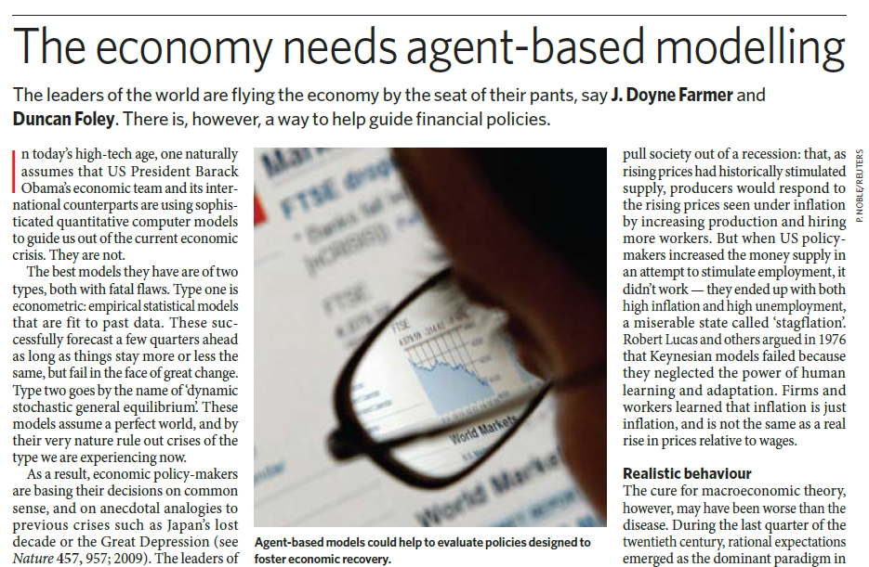
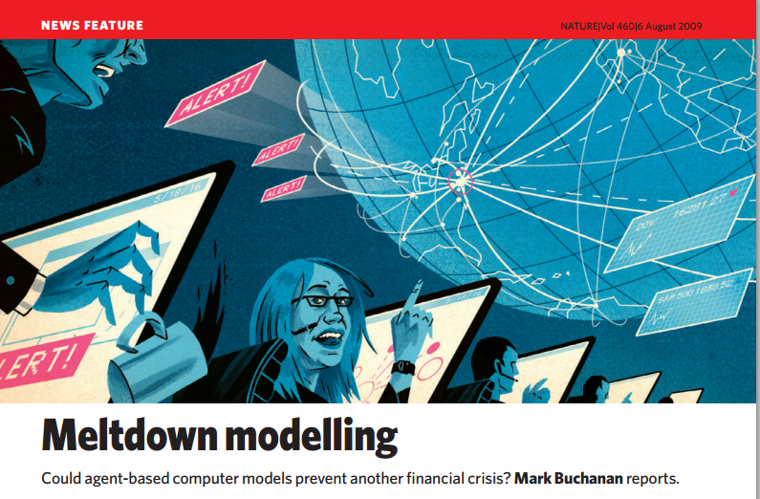
Use of Agent-Based Models in Finance and Economics
2012 Mortgage Prepayment Model
2011 Model of Financial Leverage
2009 Model of English Housing Market
2009 Bank of Italy Gross Settlements
2008 Bank of England Payment System
2007 EURACE Project of European Economy
2001 NASDAQ Decimalization Project
Notes:
First six bullet points from http://www.treasury.gov/initiatives/ofr/research/Documents/OFR_Working_Paper_No3_ABM_Bookstaber_Final.pdf , pp 12-14.
Last bullet point from http://www.treasury.gov/initiatives/ofr/research/Documents/OFR_Working_Paper_No3_ABM_Bookstaber_Final.pdf pg 18, and http://www2.econ.iastate.edu/tesfatsi/MeltDownModeling.Nature080609.Buchanan.pdf pg. 681
Images of articles http://www2.econ.iastate.edu/tesfatsi/EconomyNeedsABM.NatureAug2009.FarmerFoley.pdf and http://www2.econ.iastate.edu/tesfatsi/MeltDownModeling.Nature080609.Buchanan.pdf

Slide 10
Three Example ABMs
Deep dive into three example Agent-Based Models, to show power, promise, and pitfalls of approach:
Genetic Algorithm
Solves Iterated Prisoner’s Dilemma
Dissemination of Culture
Shows how increased interactions can lead to polarization
Illustrates how different models can be aligned in order to verify counterintuitive behavior
Impact of Financial Leverage
Hyman Minsky was right?

Slide 11
Example ABM #1: A Genetic Algorithm To Solve The Iterated Prisoner’s Dilemma

Slide 12
Prisoner’s Dilemma
Prisoner’s Dilemma:
Famous, fundamental Social Dilemma first articulated by Merrill Flood and Melvin Dresher of the RAND Corporation in 1950:
Two members of a criminal gang are arrested and imprisoned. Neither prisoner has any contact with the other. Without at least one confession, the police don't have enough evidence to convict them on the principal charge, and will have to settle for a reduced sentence. So the police offer each prisoner a Faustian bargain. Each prisoner is given the opportunity to defect, by testifying that the other committed the crime. If a prisoner chooses not to talk, then they implicitly cooperate with the other.
If they both cooperate, they both get a reward payoff (both receive the lower sentence)
If they both defect, they both are punished (both receive a higher sentence)
If one cooperates while the other defects, the cooperating one receives the sucker’s payoff (he gets blamed for the crime), while the defecting one receives the temptation (he gets off entirely).
Payoff Matrix (for prisoner 1):
Payoff always follows that:
DC > CC > DD > CD
 |  | Prisoner 2
 |  | Cooperates | Defects
Prisoner 1 | Cooperates | CC (Reward) | CD (Sucker's Payoff)
 | Defects | DC (Temptation) | DD (Punishment)
Notes:
Bullet points from William Poundstone, “Prisoner’s Dilemma,” pg. 103, 118, and 216

Slide 13
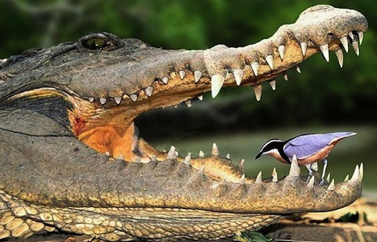
Iterated Prisoner’s Dilemma
Payoff of DC > CC > DD > CD means that a rational person should always defect on a one-time-only Prisoner’s Dilemma
But what about the scenario where the two “prisoners” interact an indefinite number of times?
“Long shadow of the future”
This scenario is an Iterated Prisoner’s Dilemma
Describes a large and eclectic number of interactions
Political Science: US – Soviet arms control talks
Sociology: Customer / Merchant transactions
Evolutionary Biology: Crocodiles / ziczacs
Notes:
“Shadow of the future” from Robert Axelrod, “Evolution of Cooperation,” pg. 12
Political science from William Poundstone, “Prisoner’s Dilemma,” pg. 253
Evolutionary Biology from William Poundstone, “Prisoner’s Dilemma,” pg. 231
Image from http://www.chicagostyleseo.com/2013/03/fortnight-feature-no-7-search-engines/

Slide 14
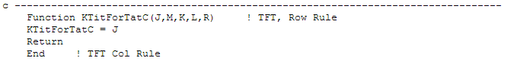
Iterated Prisoner’s Dilemma
Question: what strategy would do best in an Iterated Prisoner’s Dilemma?
To solve this, in 1980 University of Michigan Political Science Professor Robert Axelrod hosted a pair of tournaments, with entries being computer strategies to play an Iterated Prisoner’s Dilemma
Payoffs: DC = 5; CC = 3; DD = 1; CD = 0;
Contestants could examine entire history of previous moves
Tournaments went in a round robin, with each strategy playing against every other strategy, including itself (200 times in the first tournament, random number of times in the second [~151])
First tournament had 14 entries, second had 62. Both tournaments also had a random rule
Entries from economists, psychologists, political scientists, sociologists, and mathematicians
Some strategies were quite sophisticated, and modeled the opponent as a Markov process and used Bayesian inference to guess what to do next
The winner of both tournaments was the simplest strategy submitted, called Tit-for-Tat (TFT) by its author, the psychologist Anatol Rapoport
TFT cooperates initially, and then returns whatever opponent did on turn before
Fortran code for TFT, in its entirety:
Notes:
Points all from Robert Axelrod, “Evolution of Cooperation,” pg. vii, 14, 31, 193
Code for TFT from http://vserver1.cscs.lsa.umich.edu/Software/CC/CC2/TourExec1.1.f.html

Slide 15
Iterated Prisoner’s Dilemma
Iterated Prisoner’s Dilemma
Results surprised Axelrod
TFT proved to be quite robust
TFT won 2nd tournament, despite contestants knowing it won 1st tournament
TFT is collectively stable, and almost evolutionarily stable
Beyond a very low critical threshold, TFT members of a population will thrive, even in the face of extreme hostility (e.g. an All – Defect strategy)
Led Axelrod to make the following conclusions:
For a successful strategy in a durable Iterated Prisoner’s Dilemma:
Don’t be envious
Don’t treat interactions as a zero-sum game, but rather as a “win-win”
“Tit-for-Tat can’t beat anybody, but it still wins the tournament. That’s a bizarre idea. You can’t win a chess tournament by not beating anybody.”
Don’t be the first to defect
Be nice
Reciprocate both cooperation and defection
Be provocable, but be quick to forgive
Don’t be too clever
Make the method of operation clear based solely on behavior
Notes:
First set of bullet points from Richard Dawkins, “The Selfish Gene”, pg. 210-217
Second set of bullet point from Robert Axelrod, “Evolution of Cooperation,” pg. 110-122
Quote from William Poundstone, “Prisoner’s Dilemma,” pg. 241

Slide 16
Iterated Prisoner’s Dilemma
Genetic Algorithm
After 2nd tournament, participants and other researchers asked, “Is there a better strategy for an Iterated Prisoner’s Dilemma than TFT?”
To answer it, Robert Axelrod collaborated with fellow University of Michigan CS Professor John Holland to develop an adaptive / genetic algorithm
Genetic algorithm requires the specification to be in a chromosomal form, or a form that allows for mutation and adaptation
Axelrod and Holland decided that the strategy will output a C (ooperate) or D (efect) based on the previous three results. For example:
 | Pvs 3 | Pvs 2 | Pvs 1 |  | Strategy Out
 | CD | DD | DC |  | D
… 63 more combos of previous three results …
Notes:
Bullet points from Robert Axelrod, “Complexity of Cooperation,” pg. 14-28

Slide 17
Genetic Algorithm
Genetic Algorithm: Chromosomal Representation
By using previous three results, the entire strategy could be encapsulated in a vector with 4³ (or 64) entries, plus six entries for the initial premise – thus the vector would have 70 total elements
For example, the TFT strategy looks like this:
Identifier |  |  |  | TFT Out
CD | CD | CD |  | D
CD | CD | DD |  | D
CD | CD | CC |  | C
CD | CD | DC |  | C
CD | DD | CD |  | D
CD | DD | DD |  | D
CD | DD | CC |  | C
CD | DD | DC |  | C
CD | CC | CD |  | D
CD | CC | DD |  | D
CD | CC | CC |  | C
CD | CC | DC |  | C
CD | DC | CD |  | D
CD | DC | DD |  | D
CD | DC | CC |  | C
CD | DC | DC |  | C
… |  |  |  | …
DC | DC | CD |  | D
DC | DC | DD |  | D
DC | DC | CC |  | C
DC | DC | DC |  | C
Opp3 |  |  |  | *
Opp2 |  |  |  | *
Opp1 |  |  |  | C
Self3 |  |  |  | *
Self2 |  |  |  | *
Self1 |  |  |  | *
64 entries of previous three results
Strategy Vector
6 entries for initial premise
Notes:
Bullet points from Robert Axelrod, “Complexity of Cooperation,” pg. 14-28

Slide 18
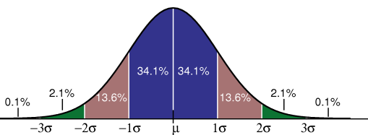
Genetic Algorithm To Solve Iterated Prisoner’s Dilemma
Genetic Algorithm: How It Works
Create initial population of 20 “individual” strategies, selected at random
For each of the 20 “individual” strategies:
Run them against the 8 “representative” strategies of the 2nd Axelrod tournament
98% of tournament score variance was explained by performance against these 8 “representatives”
For each run against a “representative”
Use premise part of chromosome as “individual” strategy’s assumption about previous 3 moves
For each of 151 moves
Make the individual’s decision to C(ooperate) or D(efect) based on the previous three moves
Make the “representative’s” move based on the strategy it represents
Add up the score according to the same payoff matrix – DC gives 5 points, CC gives 3 points, DD gives 1 point, and CD gives 0
Tally up total
At the end of the 24,160 moves, follow this “reproduction” scheme:
Individual strategies that score 1 standard deviation or below do not reproduce
Individual strategies that score 1 standard deviation or better can reproduce twice
Individual strategies that score within 1 standard deviation reproduce once
Notes:
Bullet points from Robert Axelrod, “Complexity of Cooperation,” pg. 14-28
Gaussian from http://introcs.cs.princeton.edu/java/11gaussian/

Slide 19
Genetic Algorithm: How It Works
For “reproduction,” arbitrarily pair up the successful strategies as “parents,” and have them “mate.” For “mating,” take genes from each parent around a random crossover point, plus incur random mutations (~1% of the time)
Identifier |  |  |  | Parent 1 |  | Parent 2 |  | Child
CD | CD | CD |  | D |  | C |  | C
CD | CD | DD |  | D |  | D |  | D
CD | CD | CC |  | D |  | C |  | C
CD | CD | DC |  | D |  | C |  | C
CD | DD | CD |  | D |  | D |  | D
CD | DD | DD |  | D |  | D |  | D
CD | DD | CC |  | D |  | C |  | C
CD | DD | DC |  | C |  | D |  | D
CD | CC | CD |  | C |  | D |  | D
CD | CC | DD |  | D |  | C |  | D
CD | CC | CC |  | D |  | D |  | D
CD | CC | DC |  | C |  | C |  | C
CD | DC | CD |  | C |  | C |  | C
CD | DC | DD |  | D |  | C |  | D
CD | DC | CC |  | D |  | D |  | D
CD | DC | DC |  | C |  | D |  | C
… |  |  |  | … |  | … |  | …
DC | DC | CD |  | D |  | C |  | D
DC | DC | DD |  | D |  | D |  | D
DC | DC | CC |  | D |  | D |  | C
DC | DC | DC |  | D |  | C |  | D
Opp3 |  |  |  | D |  | C |  | D
Opp2 |  |  |  | C |  | C |  | C
Opp1 |  |  |  | C |  | C |  | C
Self3 |  |  |  | C |  | D |  | C
Self2 |  |  |  | D |  | C |  | D
Self1 |  |  |  | D |  | D |  | D
Child genes come from Parent 2
Crossover point : 10th entry
Child genes come from Parent 1
Mutation
Notes:
Bullet points from Robert Axelrod, “Complexity of Cooperation,” pg. 14-28

Slide 20
Genetic Algorithm: How It Works
Each pairing of parents reproduces two child individuals for next generation
Take new generation of 20 individuals, and rerun the simulation
Repeat steps 2 and 3 on previous slides for 50 generations. This constitutes one run of the simulation.
All told, in one run:
1,208,000 moves will have been made against the 8 original “representatives” from the 2nd Axelrod tournament
1000 individuals would have been tested over 50 generations, with very successful individuals reproducing twice as often as average individuals
Notes:
Bullet points from Robert Axelrod, “Complexity of Cooperation,” pg. 14-28

Slide 21
Genetic Algorithm: Results for Iterated Prisoner’s Dilemma
Axelrod made 40 runs. He learned that 95% of the time the evolved strategies made the same choice that TFT would have made in the same situation
However, Axelrod discovered that in 11 out of 40 runs of the simulation, the median scoring individual outperformed TFT. High scoring individuals:
Broke the “be nice” rule and defected initially
Figured out what representatives could be exploited
Took advantage of at least one representative, at the expense of less cooperation with two other representatives, for a net gain
Notes:
Bullet points from Robert Axelrod, “Complexity of Cooperation,” pg. 14-28

Slide 22
Genetic Algorithm: Significance
Evolution created highly specialized adaptations perfectly suited to specific environmental situations
TFT is the perfect, generic, robust strategy
BUT with a fixed environment, specific strategies could evolve that are superior to TFT
Genetic approach proved to be a very efficient way to search the space of 2⁷⁰ strategies for those that could outperform TFT
More than 37.4T strategies would have to be tested every second in order for an exhaustive search to be completed within a year
Genetic approach proves that ABMs can adapt
Notes:
Bullet points from Robert Axelrod, “Complexity of Cooperation,” pg. 14-28

Slide 23
Example ABM #2: The Dissemination of Culture

Slide 24
Dissemination of Culture
Question: “If people tend to become more alike in their beliefs, attitudes, and behaviors when they interact, why do not all such differences eventually disappear?”
Question pursued by Robert Axelrod in the late 1990s
Relevant considering:
The dissolution off the USSR in 1991
The breakup and civil wars of Yugoslavia in the mid-1990s
The formation of the European Union and the creation of the Euro in the latter part of the decade
How is culture disseminated?
Notes:
All bullet points from Robert Axelrod, “Complexity of Cooperation,” pg. 148 -171

Slide 25
Cultural Model
“Culture” is something that people learn from one another
Axelrod modeled it as a set of features and traits
Features might represent language / dialect, religion, technologies, ideologies, norms
Traits are different values of each feature, such as English / Chinese, Christianity / Islam, industrial / information, communist / democratic, familial / community, etc.
Therefore an entity’s culture could be described by a numeric representation. For example, if the culture had five features, and each feature had 10 separate trait-values, an specific entity might look like this:
Feature 1 | Feature 2 | Feature 3 | Feature 4 | Feature 5
8 | 2 | 3 | 3 | 0
Notes:
All bullet points from Robert Axelrod, “Complexity of Cooperation,” pg. 148 -171

Slide 26
Model of Dissemination
Axelrod then created a landscape of 10 X 10 fixed “villages,” each with its own culture of five features and 10 traits / feature
Culture was disseminated between the villages according to the following algorithm:
Every cycle, one village was chosen at random to be active
One of its immediate neighbors was selected
With a probability equal to their cultural similarity, the two villages “interacted”
For example, if the villages shared traits for two out of the five features, their probability of an interaction was 40%
If the active village and its neighbor interacted, a differing feature between the two was made equal to the neighbor’s trait
Notes:
All bullet points from Robert Axelrod, “Complexity of Cooperation,” pg. 148 -171

Slide 27
Model of Dissemination
For example, here is the starting landscape of villages in Axelrod’s simulation:
If the highlighted cell becomes active, and if its southern neighbor is selected, there is a 40% chance they could interact since they share traits for two features
If they do interact, a differing feature would be taken from the southern neighbor – e.g. the “8” in 82230 might be changed to a “6” for 62330
Thus the villages would have an even higher probability of interacting in the future
74741 | 87254 | 82330 | 17993 | 22978 | 82762 | 87476 | 26757 | 99313 | 32009
01948 | 09234 | 67730 | 89130 | 34210 | 85403 | 69411 | 81677 | 06789 | 24442
49447 | 46012 | 42628 | 86636 | 27405 | 39747 | 97450 | 71833 | 07192 | 87426
22781 | 85541 | 51585 | 84468 | 18122 | 60094 | 71819 | 51912 | 32095 | 11318
09581 | 89800 | 72031 | 19856 | 08071 | 97744 | 42533 | 33723 | 24659 | 03847
56352 | 34490 | 48416 | 55455 | 88600 | 78295 | 69896 | 96775 | 86714 | 02932
46238 | 38032 | 34235 | 45602 | 39891 | 84866 | 38456 | 78008 | 27136 | 50153
88136 | 21593 | 77404 | 17043 | 39238 | 81454 | 29464 | 74576 | 41924 | 43987
35682 | 19232 | 80173 | 81447 | 22884 | 58260 | 53436 | 13623 | 05729 | 43378
57816 | 55285 | 66329 | 30462 | 36729 | 13341 | 43986 | 45578 | 64585 | 47330
Notes:
All bullet points from Robert Axelrod, “Complexity of Cooperation,” pg. 148 -171

Slide 28
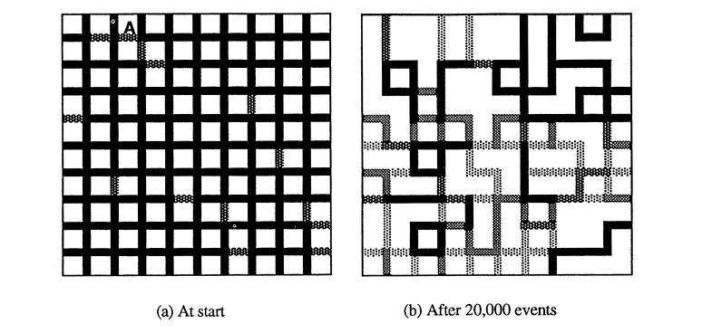
Dissemination of Culture: Results
Axelrod ran the simulation for more than 80,000 events, and saw this pattern of cultural regions develop through 20,000 events. The A is the highlighted cell from the previous slide. The boundaries represent the similarity of the cells:
Notes:
All bullet points from Robert Axelrod, “Complexity of Cooperation,” pg. 148 -171

Slide 29
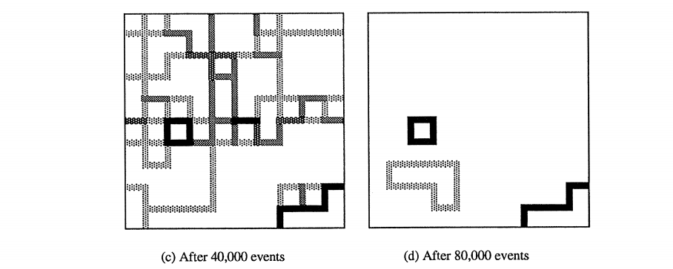
Dissemination of Culture: Results
Here is the continuing developmental pattern of cultural regions through 80,000 events. By the end of 81,000 events, there were only three regions, all of which were stable (i.e. completely unchanging)
Notes:
All bullet points from Robert Axelrod, “Complexity of Cooperation,” pg. 148 -171

Slide 30
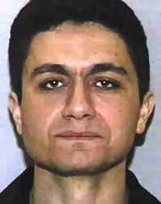
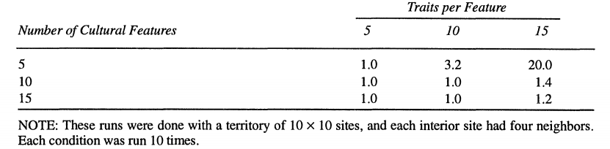
Dissemination of Culture: Results
Thus, despite interactions that touched all cells, polarization into “incompatible” regions could still develop
Further runs highlighted other features of the model:
The more features that were used to describe a culture, the more likely two cells would have “something in common,” and thus could interact further
The more traits that were available for each feature, the less likely two cells would have the same trait for a given feature, thus making interactions less likely
As a result, the number of final regions was dependent on features and traits, per this table:
For Sept. 11 hijacker Mohammed Atta, “the central theme was that his country was turning into ‘McEgypt’…Atta despised this kind of thing”
Notes:
Picture of Mohammed Atta from http://www.npr.org/2011/09/09/140321495/the-banality-of-evil-following-the-steps-to-sept-11
‘McEgypt’ quote from Der Spiegel, “Inside 9-11,” pg. 185
All bullet points from Robert Axelrod, “Complexity of Cooperation,” pg. 148 -171

Slide 31
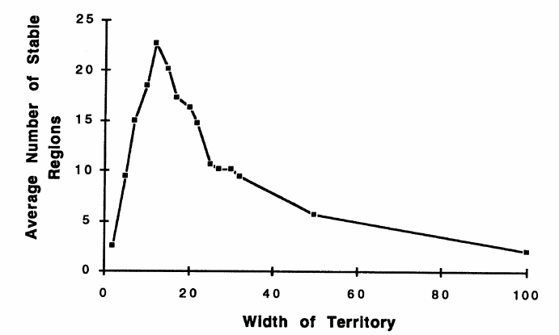
Dissemination of Culture: Results
Furthermore, in a counterintuitive finding, Axelrod discovered that the number of cultural regions did not monotonically increase with territory size:
Lesser size territories obviously have smaller numbers of final cultural regions due to lack of available cells, but larger territories likewise have smaller numbers of regions because they provide “enough” chances for interaction such that eventually all cultural regions become homogeneous
Note: The parameters for these runs are five cultural features, 15 traits per feature, and four neighbors for interior sites. Each territory size was replicated 40 times, except the territories with 50 X 50 sites and 100 X 100 sites, which were replicated 10 times.
Notes:
All bullet points from Robert Axelrod, “Complexity of Cooperation,” pg. 148 -171

Slide 32
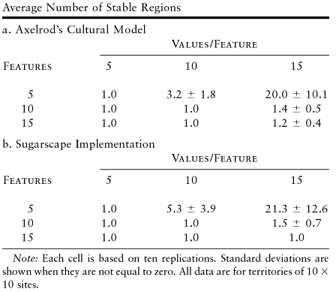
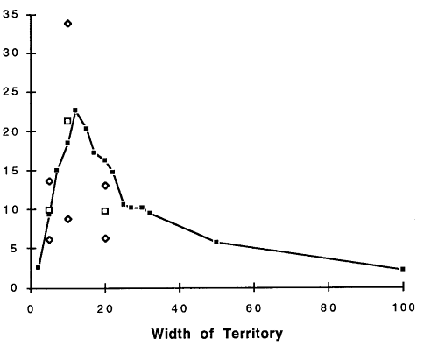
Dissemination of Culture: Results
All of these findings of Axelrod’s cultural model were later verified by IBM researchers Robert Axtell and Joshua Epstein. Axtell and Epstein coded Axelrod’s cultural model into their own simulation framework called Sugarscape
They verified the stochastic values via statistical equivalence hypothesis testing. The only statistically significant difference between systems (20 X 20 territories) was due to random selection with replacement for Axelrod, and random selection without replacement for Sugarscape
Note: The parameters for these runs are five cultural features, 15 traits per feature, and four neighbors for interior sites. Each territory size was replicated 40 times, except the territories with 50 X 50 sites and 100 X 100 sites, which were replicated 10 times.
Open squares represent Sugarscape data for 5 X 5, 10 X 10, and 20 X 20 sites / territory. Open diamonds represent Sugarscape means plus or minus one standard deviation
Notes:
All bullet points from Robert Axelrod, “Complexity of Cooperation,” pg. 183-204

Slide 33
Dissemination of Culture: Significance
Even simple models can yield counterintuitive results
Verification of models is possible
Run the models on different frameworks
Have different people encode them
Need to meet in order to iron out differences, even small ones
E.g. Random selection with replacement versus without
Use statistical equivalence to test stochastic outputs
BUT verification is not necessarily easy:
Even with this very easy model, Axelrod and Axtell took more than four months to discover the random selection problem
Notes:
Last bullet point from http://www.cs.unm.edu/~joel/cs4all/Axelrod_Chapter_ABMs_as_a_bridge_between_disciplines.pdf, pg 1577

Slide 34
Example ABM #3: Systemic Risk of Financial Leverage

Slide 35
Financial Leverage
In 2010 and 2011, Stefan Thurner et. al. created an Agent-Based Model to isolate and highlight the effects of leverage
The model consists of:
A pool of noise traders (uninformed investors, “dumb money”)
10 long-only value funds (informed investors, “smart money”)
A bank to provide leverage, set boundaries, and absorb losses
A pool of fund investors who move money around the funds, depending on their performance
A single asset of quantity N and value V, where V is known to all the funds
The performance and behavior of the funds, and their systemic impact, is analyzed under different leverage scenarios
Fund 1
Noise
Traders
Bank
Fund 2
…
Fund
Investors
Fund 10
Notes:
KEY NOTE: The concept of a single bank providing leverage is a simplification to the 2011 Thurner model (http://www.futurict.eu/sites/default/files/Report%20commissioned%20by%20the%20OECD%20on%20Systemic%20Risk,%20by%20Stefan%20Thurner.pdf ), which had multiple banks. This simplification is taken directly from the 2010 Thurner model (http://cowles.econ.yale.edu/P/cd/d17a/d1745.pdf), which used a single bank like the one here. None of the results in this presentation were dependent on single versus multiple banks. Later results in the 2011 model did depend on the number of banks, but none of those results is included here.
V known to all funds from http://www.futurict.eu/sites/default/files/Report%20commissioned%20by%20the%20OECD%20on%20Systemic%20Risk,%20by%20Stefan%20Thurner.pdf pg. 28
Other points are my own summaries / understanding of the model explained in http://www.futurict.eu/sites/default/files/Report%20commissioned%20by%20the%20OECD%20on%20Systemic%20Risk,%20by%20Stefan%20Thurner.pdf pp 25-34

Slide 36
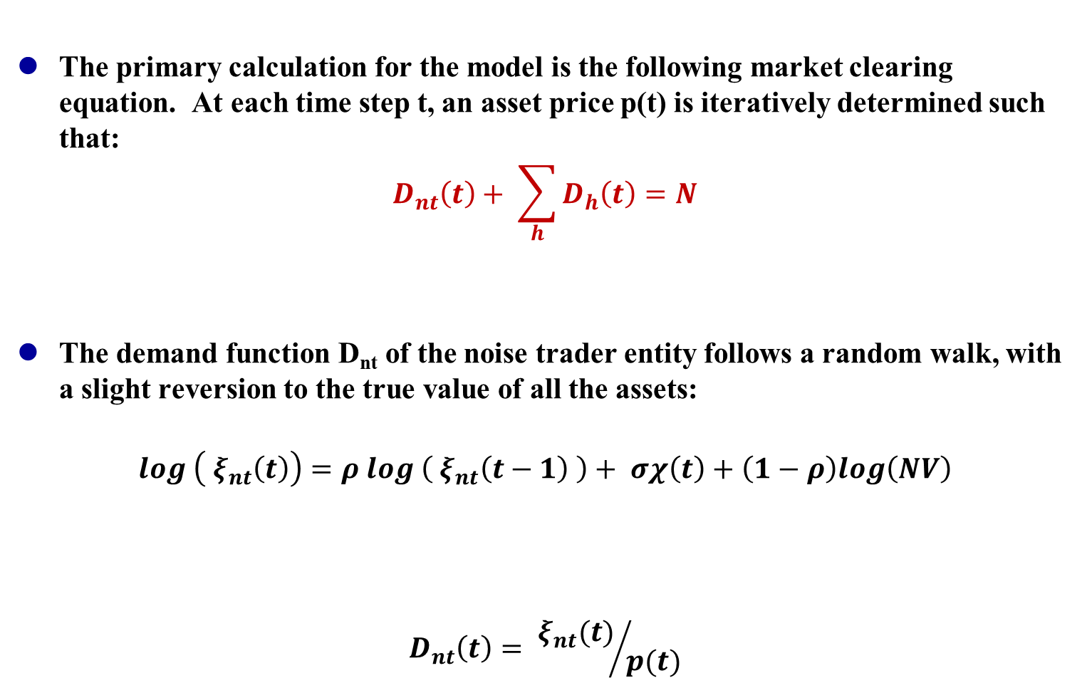
Model Essentials
The primary calculation for the model is the following market clearing equation. At each time step t, an asset price p(t) is iteratively determined such that:
$$D_{nt}\left(t\right)+ \sum_{h}{D_{h}\left(t\right)=N}$$
The demand function D_{nt} of the noise trader entity follows a random walk, with a slight reversion to the true value of all the assets:
$$log \left( ξ_{nt}\left(t\right)\right)=ρ log \left({ ξ}_{nt}\left(t−1\right) \right)+ σχ\left(t\right)+\left(1−ρ\right)log\left(NV\right)$$
$$D_{nt}\left(t\right)= {ξ_{nt}(t)}/{p(t)}$$
Noise Trader Demand
Sum of All Fund Demand
Quantity of Asset
Dollar value of Noise Trader holdings for time t
Weighted dollar value of Noise Trader holdings for previous time
Normal function (mean 0, stddev 1) scaled to particular standard deviation
Weighted true dollar value of all assets
For this model
ρ = 0.99
σ = 0.035
Noise
Traders
Noise Trader Demand
Portion of total assets demanded by Noise Traders. In the absence of funds, p(t) is just set so that this is N
Notes:
Bullet points from http://www.futurict.eu/sites/default/files/Report%20commissioned%20by%20the%20OECD%20on%20Systemic%20Risk,%20by%20Stefan%20Thurner.pdf pg. 27

Slide 37
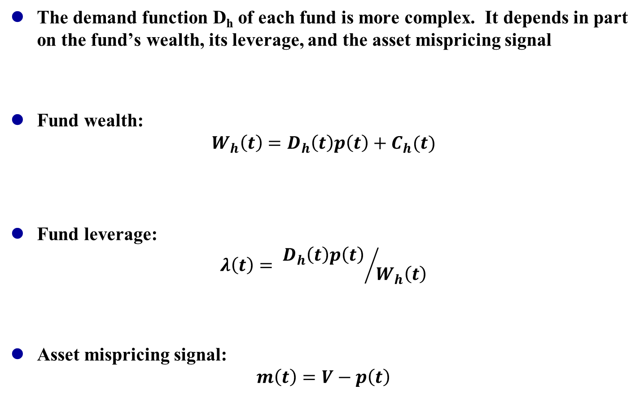
Fund Demand
The demand function D_{h} of each fund is more complex. It depends in part on the fund’s wealth, its leverage, and the asset mispricing signal
Fund wealth:
$$W_{h}\left(t\right)=D_{h}\left(t\right)p\left(t\right)+C_{h}(t)$$
Fund leverage:
$$λ\left(t\right)= {D_{h}\left(t\right)p\left(t\right) }/{W_{h}\left(t\right)}$$
Asset mispricing signal:
$$m\left(t\right)=V−p\left(t\right)$$
Fund 1
Fund 2
…
Fund 10
Wealth of fund h
Monetary value of fund assets
Cash holdings of fund h. NOTE that this value may be NEGATIVE if the fund borrows money to buy more of the asset
Leverage ratio
Value of fund assets
Wealth of fund h
The farther away the price p(t) is from the true value V of the asset, the stronger the signal
Mispricing
Asset
true value
Notes:
First bullet point from http://www.futurict.eu/sites/default/files/Report%20commissioned%20by%20the%20OECD%20on%20Systemic%20Risk,%20by%20Stefan%20Thurner.pdf pg. 27
Second and third bullet points from http://www.futurict.eu/sites/default/files/Report%20commissioned%20by%20the%20OECD%20on%20Systemic%20Risk,%20by%20Stefan%20Thurner.pdf pg. 28

Slide 38
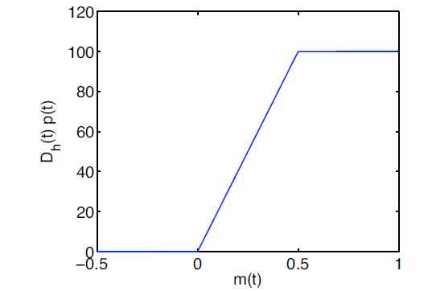
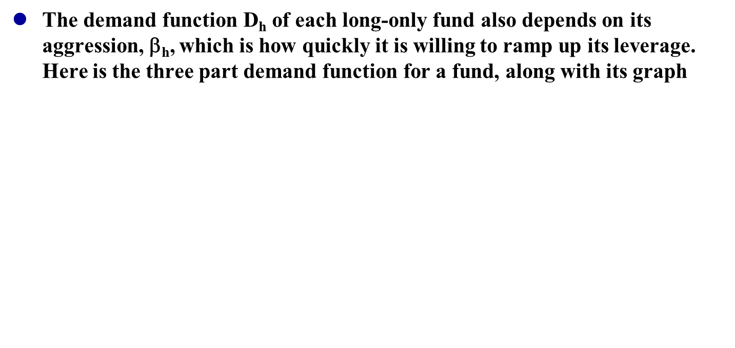
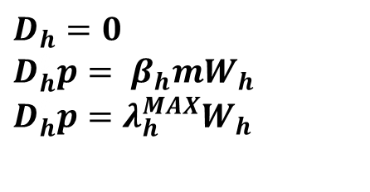
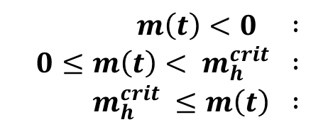
Fund Demand
The demand function D_{h} of each long-only fund also depends on its aggression, β_{h}, which is how quickly it is willing to ramp up its leverage. Here is the three part demand function for a fund, along with its graph
$$m\left(t\right)<0 :$$
$$0≤m\left(t\right)< m_{h}^{crit} :$$
$$m_{h}^{crit} ≤m\left(t\right) :$$
$$D_{h}=0$$
$D_{h}^{t}p= β_{h}mW_{h}$
$D_{h}^{t}p=$ ${λ_{h}^{MAX}W}_{h}$
If the asset is overvalued, the fund does nothing
If the asset is undervalued, the fund buys until it reaches maximum leverage
If the fund is fully leveraged, its demand is flat
Notes:
Equations from http://www.futurict.eu/sites/default/files/Report%20commissioned%20by%20the%20OECD%20on%20Systemic%20Risk,%20by%20Stefan%20Thurner.pdf pp. 28-9
Graph from http://www.futurict.eu/sites/default/files/Report%20commissioned%20by%20the%20OECD%20on%20Systemic%20Risk,%20by%20Stefan%20Thurner.pdf pg. 29

Slide 39
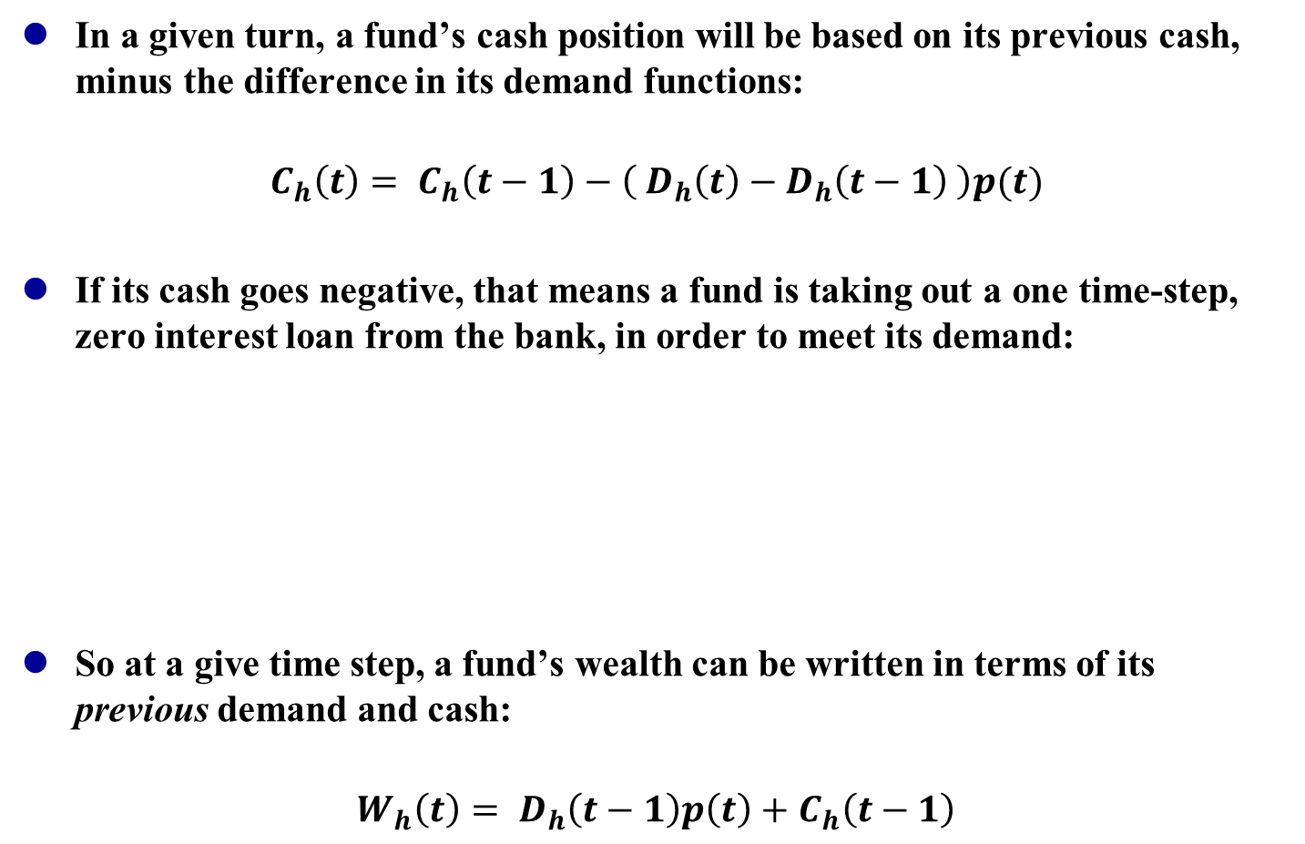
Fund Cash and Borrowings
In a given turn, a fund’s cash position will be based on its previous cash, minus the difference in its demand functions:
$$C_{h}\left(t\right)= C_{h}\left(t−1\right)−\left({ D}_{h}\left(t\right)−D_{h}\left(t−1\right) \right)p(t)$$
If its cash goes negative, that means a fund is taking out a one time-step, zero interest loan from the bank, in order to meet its demand:
So at a give time step, a fund’s wealth can be written in terms of its previous demand and cash:
$$W_{h}\left(t\right)= {D_{h}\left(t−1\right)p\left(t\right)+C}_{h}\left(t−1\right)$$
Fund 1
Bank
Fund 2
…
Fund 10
Notes:
First and second bullet points from http://www.futurict.eu/sites/default/files/Report%20commissioned%20by%20the%20OECD%20on%20Systemic%20Risk,%20by%20Stefan%20Thurner.pdf pg. 28
Last bullet point from http://www.futurict.eu/sites/default/files/Report%20commissioned%20by%20the%20OECD%20on%20Systemic%20Risk,%20by%20Stefan%20Thurner.pdf pg. 29

Slide 40
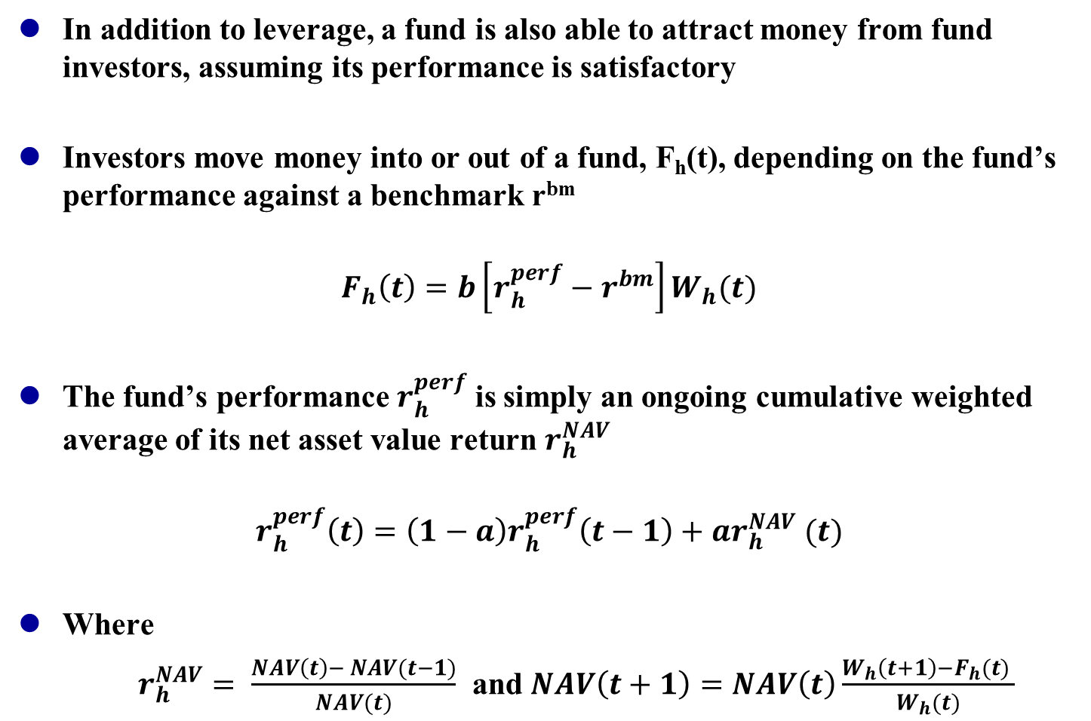
Fund Investors
In addition to leverage, a fund is also able to attract money from fund investors, assuming its performance is satisfactory
Investors move money into or out of a fund, F_{h}(t), depending on the fund’s performance against a benchmark r^{bm}
$$F_{h}\left(t\right)=b\left[r_{h}^{perf}−r^{bm}\right]W_{h}(t)$$
The fund’s performance $r_{h}^{perf}$ is simply an ongoing cumulative weighted average of its net asset value return $r_{h}^{NAV}$
$$r_{h}^{perf}\left(t\right)=\left(1−a\right)r_{h}^{perf}\left(t−1\right)+ar_{h}^{NAV} (t)$$
Where
$r_{h}^{NAV}= \frac{NAV\left(t\right)− NAV(t−1)}{NAV(t)}$ and $NAV\left(t+1\right)=NAV\left(t\right)\frac{W_{h}\left(t+1\right)−F_{h}(t) }{W_{h}(t)}$
Fund
Investors
Fund 1
For this model:
r^{bm} = 0.005
b = 0.15
For this model:
a = 0.1
NAV(0) = 1
W_{h}(0) = 2
Notes:
All equations and values from http://www.futurict.eu/sites/default/files/Report%20commissioned%20by%20the%20OECD%20on%20Systemic%20Risk,%20by%20Stefan%20Thurner.pdf pg. 31

Slide 41
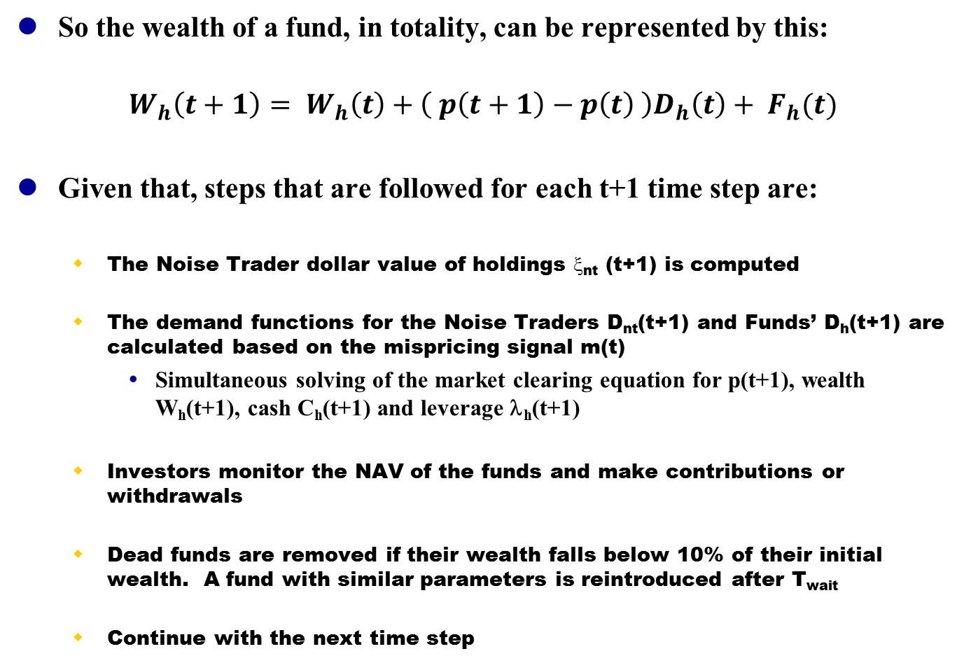
Final Points
So the wealth of a fund, in totality, can be represented by this:
$$W_{h}\left(t+1\right)= W_{h}\left(t\right)+\left( p\left(t+1\right)−p\left(t\right) \right)D_{h}\left(t\right)+ F_{h}(t)$$
Given that, steps that are followed for each t+1 time step are:
The Noise Trader dollar value of holdings ξ_{nt} (t+1) is computed
The demand functions for the Noise Traders D_{nt}(t+1) and Funds’ D_{h}(t+1) are calculated based on the mispricing signal m(t)
Simultaneous solving of the market clearing equation for p(t+1), wealth W_{h}(t+1), cash C_{h}(t+1) and leverage λ_{h}(t+1)
Investors monitor the NAV of the funds and make contributions or withdrawals
Dead funds are removed if their wealth falls below 10% of their initial wealth. A fund with similar parameters is reintroduced after T_{wait}
Continue with the next time step
For this model:
T_{wait} = 100 steps
Notes:
Wealth of a fund given by http://www.futurict.eu/sites/default/files/Report%20commissioned%20by%20the%20OECD%20on%20Systemic%20Risk,%20by%20Stefan%20Thurner.pdf pg. 31
Steps from http://www.futurict.eu/sites/default/files/Report%20commissioned%20by%20the%20OECD%20on%20Systemic%20Risk,%20by%20Stefan%20Thurner.pdf pg. 33

Slide 42
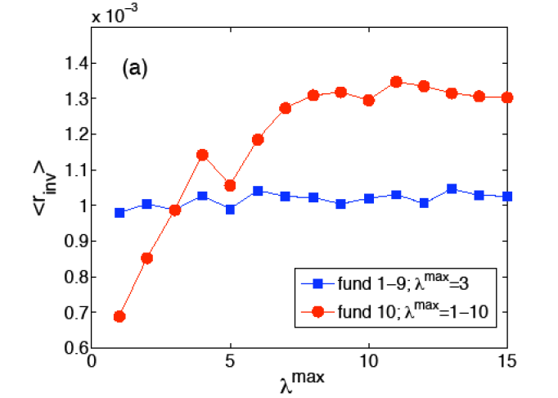
Model Results
First, there is evolutionary demand for funds to increase leverage. The funds that take on more leverage provide higher returns to investors:
See More Defaults
Notes:
Graph from http://www.futurict.eu/sites/default/files/Report%20commissioned%20by%20the%20OECD%20on%20Systemic%20Risk,%20by%20Stefan%20Thurner.pdf pg. 45

Slide 43
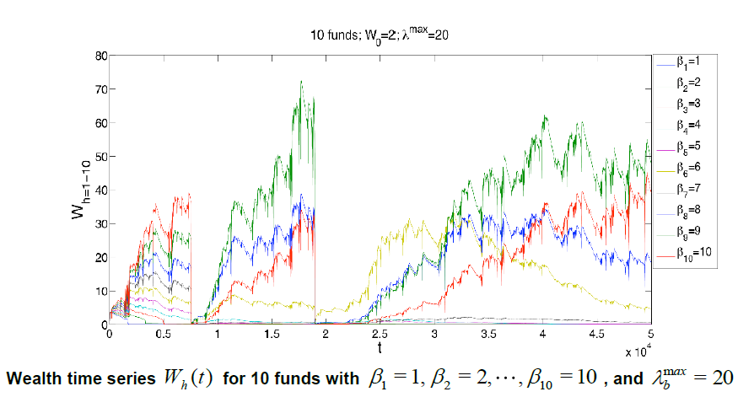
Model Results
But while leverage can lead to enhanced returns and great accumulations of wealth, it can also lead to precipitous crashes:
See High β Funds
Notes:
Graph from http://www.futurict.eu/sites/default/files/Report%20commissioned%20by%20the%20OECD%20on%20Systemic%20Risk,%20by%20Stefan%20Thurner.pdf pg. 35

Slide 44
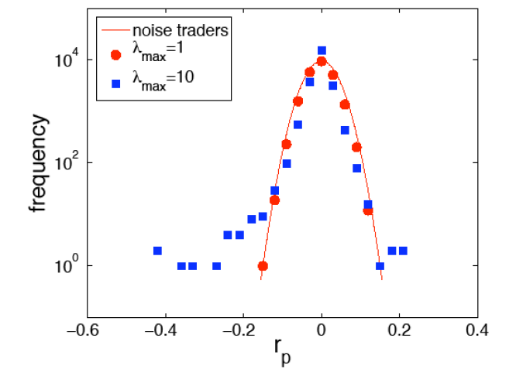
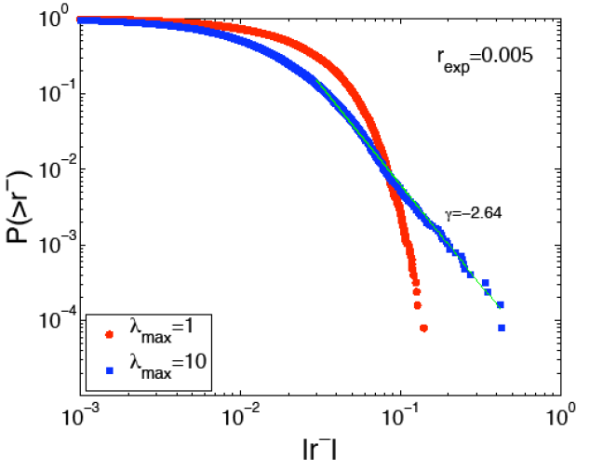
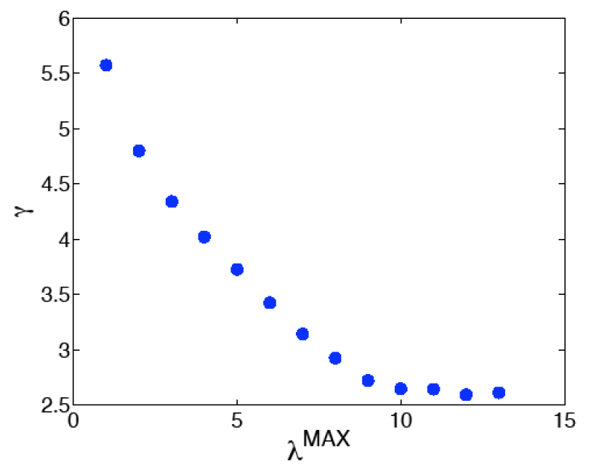
Model Results
And fatter tails in return distributions:
Notes:
Upper two graphs from http://www.futurict.eu/sites/default/files/Report%20commissioned%20by%20the%20OECD%20on%20Systemic%20Risk,%20by%20Stefan%20Thurner.pdf pg. 39
Bottom graph from http://www.futurict.eu/sites/default/files/Report%20commissioned%20by%20the%20OECD%20on%20Systemic%20Risk,%20by%20Stefan%20Thurner.pdf pg. 40

Slide 45
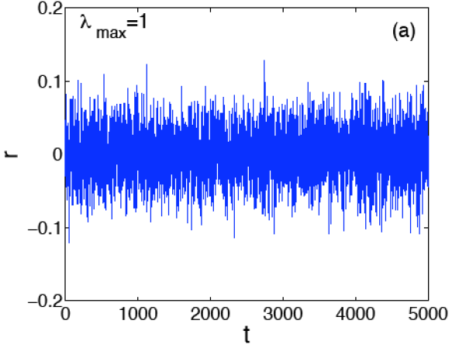
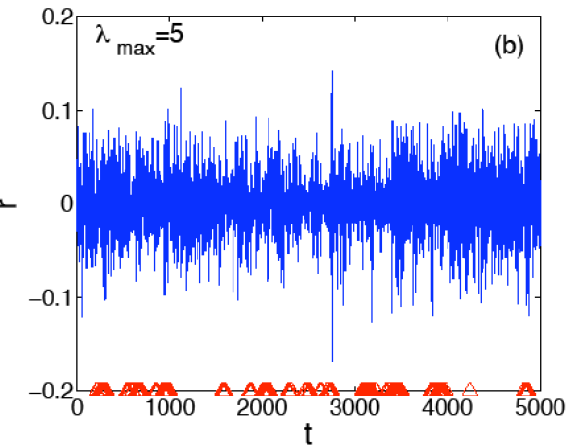
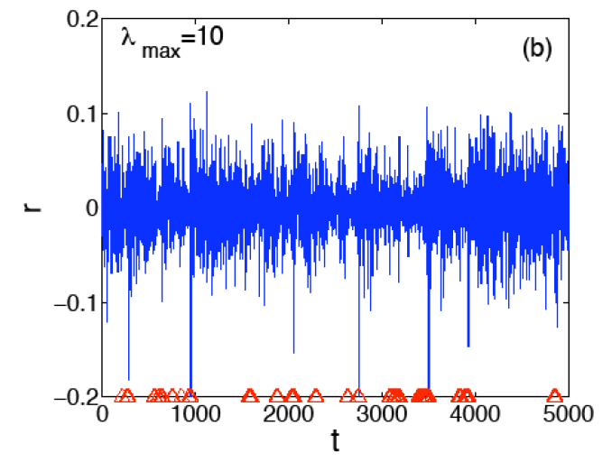
Model Results
And more clustered volatility:
Notes:
Graphs from http://www.futurict.eu/sites/default/files/Report%20commissioned%20by%20the%20OECD%20on%20Systemic%20Risk,%20by%20Stefan%20Thurner.pdf pp. 41-2

Slide 46
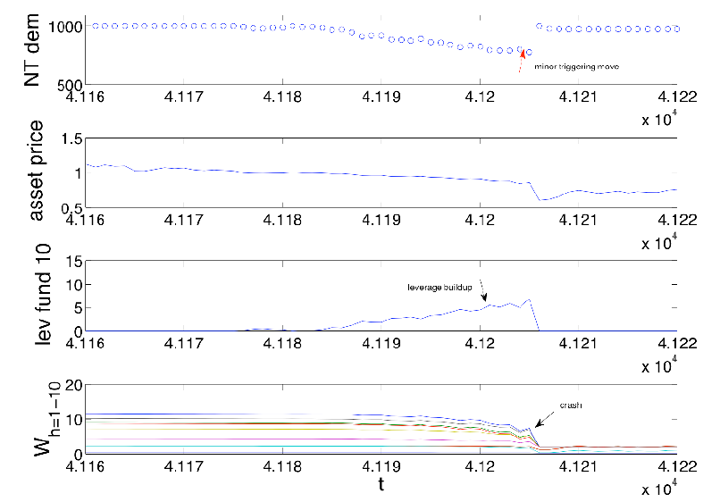
Model Results
With enough leverage, even a small perturbation can lead to a crash:
Anatomy of a Crash: Leverage builds up in the 10-fund, λ_{max} = 5, β 5-50 system, until a small perturbation in Noise Trader Demand causes asset prices to crash in 3 time steps. Crashes involve the nonlinear interplay between prices and leverage.
Notes:
Graph from http://www.futurict.eu/sites/default/files/Report%20commissioned%20by%20the%20OECD%20on%20Systemic%20Risk,%20by%20Stefan%20Thurner.pdf pg. 44

Slide 47
Financial Leverage: Significance
According to the model, leverage can make the financial system more unstable. It can lead to precipitous crashes, fatter tails of returns, clustered volatility, and fragility in the face of small perturbations
None of these effects required exogenous shocks. All were completely generated by endogenous interactions of agents.
Is Hyman Minsky right? Minsky’s theory is:
Initial investors after a positive structural event typically are not leveraged – they are hedged because their cash outlays are covered by cash receipts
Later, additional speculative investors use leverage to improve upon the yields – they can meet interest payments, but not principal payments. Debt must be rolled
Final, Ponzi investors join the party, but they cannot even meet interest payments (let alone principal payments), and must take on still more debt just to remain in business
Final disruptive event occurs, “a Minsky moment,” and markets violently reprice
BUT – how well does the leverage model portray reality?
Does the model really show the underlying effects of leverage, or just the specific values chosen for arbitrary weights?
How were the weights for Noise Trader demand and benchmark performance contributions / withdrawals determined?
Notes:
Second bullet point from http://www.futurict.eu/sites/default/files/Report%20commissioned%20by%20the%20OECD%20on%20Systemic%20Risk,%20by%20Stefan%20Thurner.pdf pg. 59
Minsky explanation from Charles Morris, “The Trillion Dollar Meltdown”, pp. 133-4

Slide 48
Agent-Based Model Limitations
At best, ABM results merely illustrate that a model is sufficient to explain an emergent phenomenon – not that it is the underlying cause
Even ABM aficionados emphasize that agent models should not be used for predictions – just explanations
ABMs cannot explain or predict “disruptive” inventions / innovations
ABMs often have a lot of variable parameters. Critics claim that even when a model matches reality, it’s not clear whether that was just due to a careful tuning of the parameters, or due to the model capturing realistic system dynamics
The Financial Leverage model had multiple arbitrary parameters, including the:
Weighting of the Noise Trader random walk components
Weighting of fund flow movements
Benchmark performance
Notes:
Second and third bullet points from http://www.futurict.eu/sites/default/files/Report%20commissioned%20by%20the%20OECD%20on%20Systemic%20Risk,%20by%20Stefan%20Thurner.pdf, pg. 20
Fourth main bullet point from http://www2.econ.iastate.edu/tesfatsi/MeltDownModeling.Nature080609.Buchanan.pdf pg. 681

Slide 49
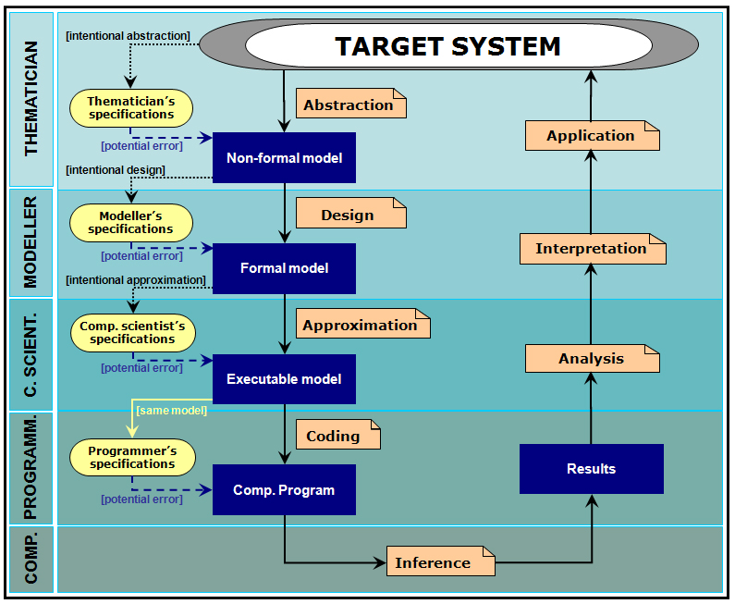
Agent-Based Model Error Sources
As with ordinary modeling, ABMs can have errors introduced at any number of different points in the process:
Person who thinks of the idea
Person who comes up with the
(mathematical) behavior
Person who considers the
computational portions of the
model
Person who programs the model
Notes:
Graph from http://jasss.soc.surrey.ac.uk/12/1/1.html section 2.11

Slide 50
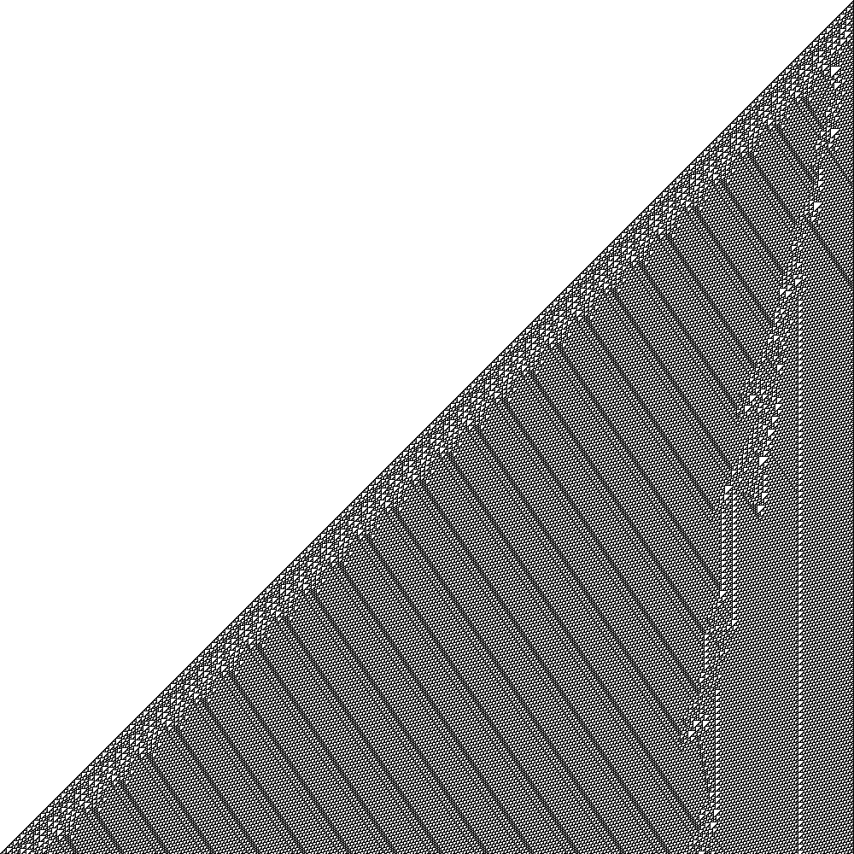
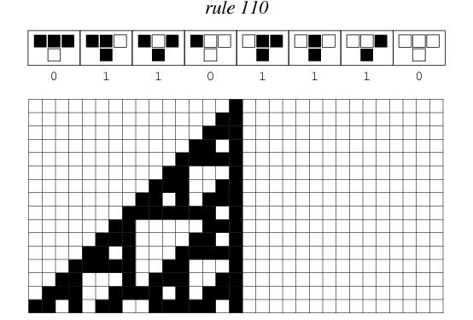
Agent-Based Model Compounding
But, unlike ordinary modeling, errors in the Agent-Based Modeling process can compound in mysterious ways. This visual representation of a simple ABM shows compounding turning into remarkable complexity, with different regimes of regularity interspersed with seemingly random behavior:
➔
1000 generations of rule 110
16 generations of rule 110
Notes:
Left graph from http://mathworld.wolfram.com/Rule110.html
Right graph from http://en.wikipedia.org/wiki/File:CA_rule110.png

Slide 51
Agent-Based Model Artifacts
Because of this compounding ABMs are particularly vulnerable to an insidious type of error called an artifact, which is an assumption that is originally deemed to be insignificant – and potentially not even communicated between the modeler and computer scientist – but which ends up playing a material role in the results
Possible Examples:
Selection of pseudo-random number generator
Floating point arithmetic assumptions
Random sampling with replacement versus without (see Dissemination of Culture)
Assumption Importance / Model Impact | Core | Accessory
Significant | Phenomenon under examination | Artifact
Insignificant | (Model needs simplification) | Not a crucial part of the model. Often included merely to make the model work
Notes:
First bullet point from http://jasss.soc.surrey.ac.uk/12/1/1.html, section 3.7

Slide 52
Agent-Based Model Limitations
Given the layers of modeller assumptions that are necessary to make an ABM work:
Assumptions for n different types of heterogeneous agents
Assumptions for n(n-1)/2 different types of interactions between heterogeneous agents
Assumptions on mode of stochastic behavior
Given the layers of computer scientist / programmer assumptions that are necessary to make an ABM work:
Operating system assumptions
Floating point arithmetic assumptions
Boundary condition assumptions
Random number generation
Artifacts can arise at any number of points!!
And further, dynamics of ABMs are generally sufficiently complex that model developers themselves often don’t understand in exhaustive detail how the obtained results have been produced
Importance of keeping the models as simple as possible
Notes:
Last main bullet point from http://jasss.soc.surrey.ac.uk/12/1/1.html section 3.10

Slide 53
Agent-Based Model Tradeoffs
These issues have lead ABM practitioners to emphasize the various tradeoffs in the validation, verification, and calibration of the models
Validation: making sure the right model is being built
Trade-offs between keeping the model simple, and capturing the complexity of the world
Verification: making sure the model is being built right
Trade-offs between costs of implementing the model with different platforms, and not knowing the impact of possible artifacts
The Dissemination of Culture model hints at the difficulty in verifying models
Calibration: estimating the model parameters to make sure the data fits the real world
Trade-off between qualitative and quantitative understanding of systemic properties
ABMs help understand systemic properties qualitatively. To make them quantitatively useful, ABMs must be scaled with real data, often in the form of networks (e.g. asset / liability networks, financial flows, etc.)
Requires tremendous joint efforts in scientific research, data generation, and institutional cooperation
Notes:
Bullet points from from http://www.treasury.gov/initiatives/ofr/research/Documents/OFR_Working_Paper_No3_ABM_Bookstaber_Final.pdf pg. 15
Last bullet points under calibration from http://www.futurict.eu/sites/default/files/Report%20commissioned%20by%20the%20OECD%20on%20Systemic%20Risk,%20by%20Stefan%20Thurner.pdf pg. 10-11

Slide 54
What Can We Learn From This?
Agent-Based Models are powerful tools for revealing adaptive behaviors, systemic dynamics, and network effects
Can help highlight uncertainty, and reveal counterintuitive phenomena
BUT have lots of tradeoffs in terms of time and cost. Even the simplest models can be very expensive to verify, much less validate and calibrate
AND THUS ABMs must be used with extreme care, and much skepticism. Errors and compounding can easily lead to artifacts impacting real results

Slide 55
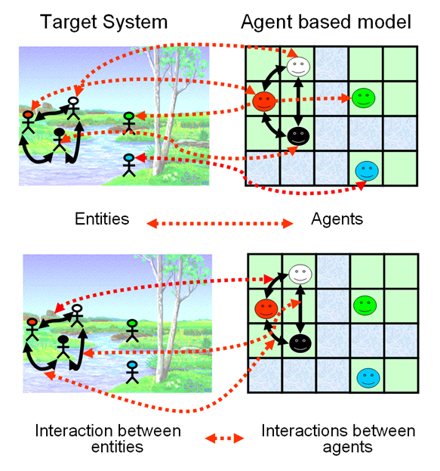
Thank You!
Notes:
Graph from http://jasss.soc.surrey.ac.uk/12/1/1.html section 2.6

Slide 56
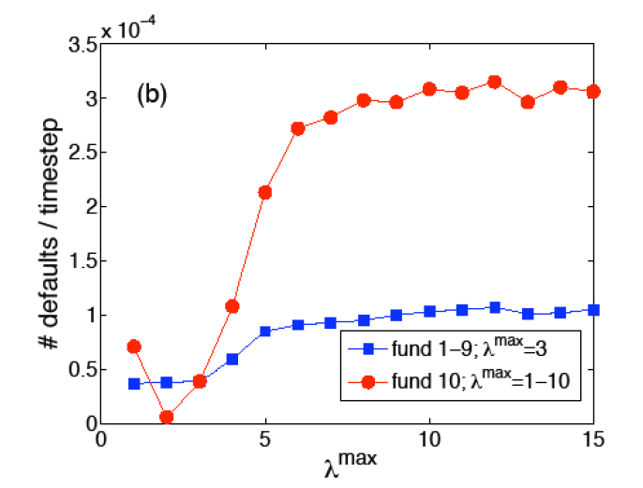
Appendix: More Defaults
Funds that take on more leverage also suffer from more defaults:
Go Back
Notes:
Graph from http://www.futurict.eu/sites/default/files/Report%20commissioned%20by%20the%20OECD%20on%20Systemic%20Risk,%20by%20Stefan%20Thurner.pdf pg. 46

Slide 57
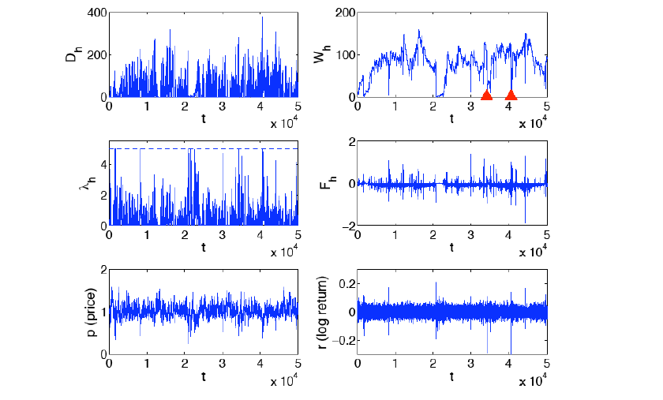
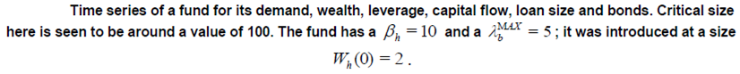
Appendix: Dynamics of Single Fund
A single fund’s wealth can grow to an upper bound, where its own actions can significantly impact the market:
Notes:
Graph from http://www.futurict.eu/sites/default/files/Report%20commissioned%20by%20the%20OECD%20on%20Systemic%20Risk,%20by%20Stefan%20Thurner.pdf pg. 36

Slide 58
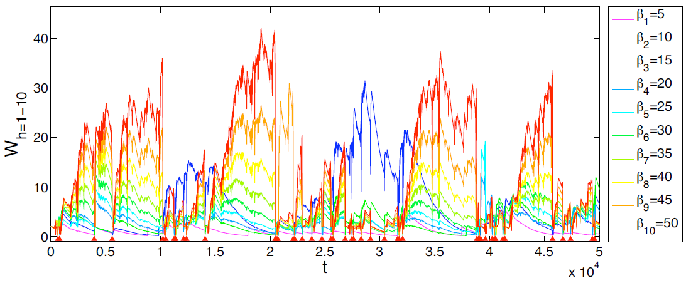
Appendix: Dynamics of Single Fund
Appendix: High β Fund Results
The dynamics of the system depend on the funds’ aggressiveness parameter β. The more aggressive the funds, the more boom-and-bust cycles:
Notes:
Graph from http://cowles.econ.yale.edu/P/cd/d17a/d1745.pdf pg. 7

Slide 59
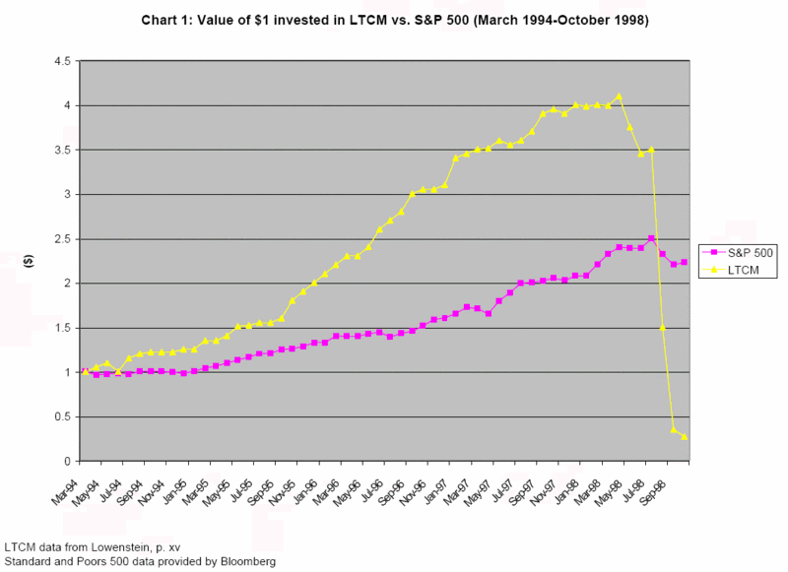
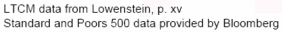
Appendix: Dynamics of Single Fund
Appendix: LTCM Results
The hedge fund Long Term Capital Management (LTCM), run by John Meriwether (of Liars Poker fame) and staffed with Nobel-Prize winners Robert Merton and Myron Scholes, has a performance chart eerily reminiscent of the aggressive, highly levered funds in the study:
Go Back
Notes:
Graph from http://vixandmore.blogspot.com/2007/08/2007-vs-1998-or-subprime-vs-ltcm.html

Slide 60
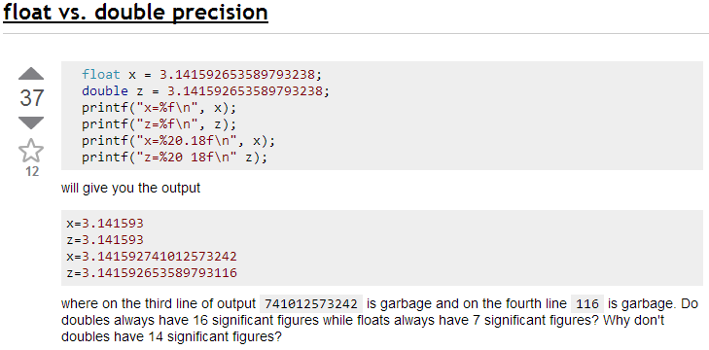
Appendix: Numerical Precision
Computers have different numerical types to represent different degrees of precision. In the C language example below, neither floats nor doubles provide the specified degree of precision – the only difference is how wrong they are:
Go Back
Notes:
Example from: http://stackoverflow.com/questions/5098558/float-vs-double-precision

Slide 61

Appendix: Desert Crossing
In December 1998, the US struck 97 targets in Baghdad, and almost knocked Saddam Hussein from power. Arab allies in the region (especially Saudi Arabia) asked CENTCOM Commander Anthony Zinni, “Do you guys have a plan?”
In response, Zinni organized the Desert Crossing wargame, a three-day seminar in June 1999, to identify interagency issues on how to manage change in a post-Saddam Iraq
Results of the wargame were very pessimistic, and anticipated regional instability, as well as fragmentation along religious and ethnic lines
Did not believe creation of democratic Iraqi government was feasible
Mentioned 300,000 US ground troops necessary
Prescient findings ignored by Pentagon before start of 2003 invasion
“’You need to dust off Desert Crossing. They said, ‘What’s that? Never heard of it… We’ve been told not to do any of the planning. It would all be done in the Pentagon.”
Notes:
97 targets bullet point from Thomas Ricks, “Fiasco”, pg. 20
Wargame results and democratic Iraqi government from http://www2.gwu.edu/~nsarchiv/NSAEBB/NSAEBB207/
300,000 troops from http://www2.gwu.edu/~nsarchiv/NSAEBB/NSAEBB207/Desert%20Crossing%20After%20Action%20Report_1999-06-28.pdf, pg. 20
Quote from http://www2.gwu.edu/~nsarchiv/NSAEBB/NSAEBB207/

Slide 62
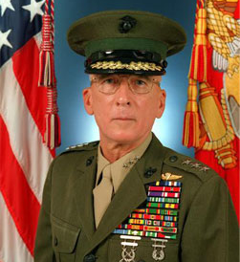
Appendix: Millennium Challenge
In July-August 2002, the US conducted an enormous wargame exercise called the Millennium Challenge, to determine attack plans against a “rogue military commander.” General Paul Van Riper was selected to play the rogue commander
In the wargame, Van Riper used unexpected tactics to elude superior US technology, including motorcycle couriers to send messages, and lighting systems to launch airplanes
Also used “swarm tactics” with a fleet of small boats, launching enough cruise missiles to sink 16 boats, including an aircraft carrier, 10 cruisers, and five of six amphibious craft. Approximately 20,000 US service personnel were killed in the simulated attack
Military ended up “refloating” fleet, and denying Van Riper the ability to use his tactics. US Military won the “do-over” wargame, and Van Riper resigned in protest
In late 2007, five Iranian PT boats charged a three-boat Navy convoy in the Strait of Hormuz, using similar tactics to Van Riper. They adroitly maneuvered between a US destroyer, cruiser and frigate, only pulling up just before the US Navy opened fire
Notes:
First bullet point from Malcolm Gladwell, “Blink”, pg. 102
Picture of Van Riper from http://www.pbs.org/wgbh/nova/military/immutable-nature-war.html
Second bullet point from Malcolm Gladwell, “Blink”, pg. 109-110
Third bullet point from http://www.foreignpolicy.com/articles/2010/02/22/the_new_rules_of_war and http://en.wikipedia.org/wiki/Millennium_Challenge_2002
Fourth bullet point from http://www.slate.com/articles/news_and_politics/war_stories/2003/03/wargamed.html
Last bullet point from http://www.nytimes.com/2008/01/12/washington/12navy.html?_r=0

Slide 63
References
Principal Source:
Using Agent-Based Models for Analyzing Threats to Financial Stability, Richard Bookstaber
Books:
Complexity of Cooperation, Robert Axelrod
Evolution of Cooperation, Robert Axelrod
A Demon of Our Own Design, Richard Bookstaber
The Selfish Gene, Richard Dawkins
Blink, Malcolm Gladwell
Trillion Dollar Meltdown, Charles Morris
Prisoner’s Dilemma, William Poundstone
Fool’s Gold, Gillian Tett
Fiasco, Thomas Ricks
Others as noted in the text
Papers:
Systemic financial risk: agent based models to understand the leverage cycle on national scales and its consequences, Stefan Thurner
The Risks of Financial Modeling: VaR and the Economic Meltdown, Report to Congress, September 10, 20098
Office of Financial Research 2012 Annual Report
Others as noted in the text

